Slide 1

KIP GIT GROUP ASSIGNMENT
GROUP - 1
COMMIT
Jagdish Singh
Soumya Dubey
Kaspe Aravind Kumar
Satyajit Sahu
V. Shilpitha Prasad

Slide 2
GIT COMMIT
The commit command is used to record changes to a local repository after staging in git.
Before saving the changes in git, it has to be mentioned to git which changes are being saved as there might be tons of edits.
A great way to do that is by adding a commit message to identify your changes.

Slide 3
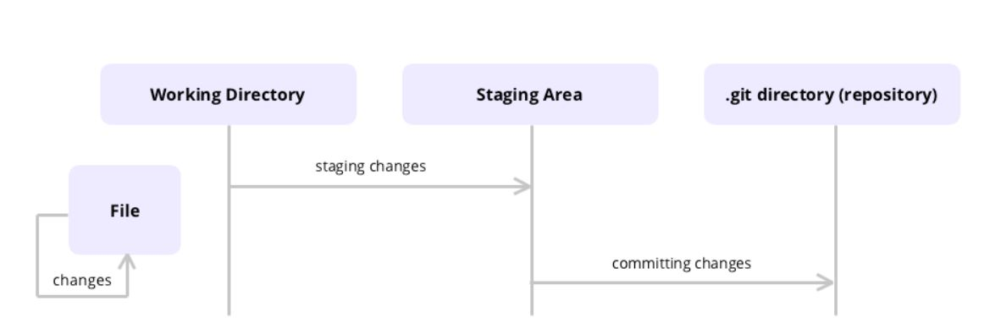
PROCESS TO COMMIT

Slide 4
FREQUENTLY USED COMMIT OPTIONS
-m : This option sets the commit's message. git add . git commit -m "This is a group assignment"
-a or --all :This option automatically commits all (including new) tracked, modified or deleted files. git commit -a -m "This is a group assignment"
--amend : This option rewrites the very last commit with any currently staged changes or a new commit message and should only be performed on commits that have not been pushed to a remote repository, yet. git add . git commit --amend -m "This is a group assignment"

Slide 5
WHY A GOOD COMMIT MESSAGE IS NEEDED ?
A well-crafted Git commit message is the best way to communicate context about a change to other developers working on that project, and indeed, to your future self.
A project’s long-term success rests (among other things) on its maintainability, and a maintainer has few tools more powerful than his project’s log.
A good commit message makes understanding easy why something happened months or years ago not only possible but efficient.
The benefits of writing good commit messages are not only limited to your team, but indeed expand to yourself and future contributors.

Slide 6
HOW TO WRITE A GOOD COMMIT MESSAGE
The seven rules to write a great git commit message :
Separate subject from the body with a blank line
Limit the subject line to 50 characters
Capitalise the subject line
Do not end the subject line with a period
Use the imperative mood in the subject line
Wrap the body at 72 characters
Use the body to explain what and why v/s how

Slide 7
REFERENCES
https://chris.beams.io/posts/git-commit/
https://www.freecodecamp.org/news/a-beginners-guide-to-git-how-to-write-a-good-commit-message/
https://git-scm.com/docs/git-commit
https://www.bitdegree.org/learn/git-commit-command#:~:text=In%20Git%2C%20commit%20is%20the,the%20local%20repository%20of%20Git.

Slide 8


